Slide 1
Odor part, pair part: what the split is in the response vectors
ANALYSIS NOTE · THE DECOMPOSITION
A short proof, a picture and a numerical check, for anyone who wants to know whether splitting a correlation matrix into an additive odor part and a pair part corresponds to something real in the population response vectors.
Jonathan Kenny · Caltech · October 2026
17 odors · 136 odor pairs · N = 689 ROIs · toy: 6 odors in the plane
Notes:
This is a note for a labmate who asked whether the odor part and pair part in Figure 7 are a curve fit or something in the data. The answer is that they are an exact algebraic expansion of the Gram matrix of the response vectors. Everything today is plane geometry: no statistics until the numeric check.

Slide 2
The two parts are the additive and interaction terms of an exact identity, not a curve fit
IN ONE SLIDE
Every r splits into four terms
The odor part is ⟨dᵢ, m⟩
The pair part is ⟨dᵢ, dⱼ⟩
rᵢⱼ = ‖m‖² + ⟨dᵢ, m⟩ + ⟨dⱼ, m⟩ + ⟨dᵢ, dⱼ⟩, where m is the mean unit pattern and dᵢ each odor’s deviation from it. An identity in ℝᴺ; no approximation.
How far odor i’s pattern leans toward the shared pattern. The off-diagonal least-squares fit returns it exactly, times 17/15, plus a constant that drops out.
What two patterns share once the shared pattern is removed. Its matrix has zero row sums, so it carries no odor-level signal by construction. A small additive leak, 2/(n − 2) = 0.13, cannot create pair structure.
The residual “claws beyond boutons” inherits the same meaning, because every step from r to the residual is affine and the fit is linear.
Odor part, pair part · 2 · Overview
Section 1 of 6 · Overview
Notes:
Nobody should wait for the point. Three claims: the four-term identity, what the fitted odor values are, what the pair part is. The band is Proposition 3, which is the one that matters for Figure 7. Admit now that the identity settles what the parts are, not how to interpret them; the limits come at the end.

Slide 3
Six short sections, built step by step
OUTLINE
1
Overview: the answer, this outline and the terms used
Slides 1–4
2
Setup: Pearson r is a dot product; each odor is the shared pattern plus a deviation
Slides 5–6
3
Proposition 1: every correlation splits exactly into four terms
Slides 7–8
4
Why the pair part is something real: three pairs, three different splits
Slide 9
5
Propositions 2 and 3: the fitted odor values, and the residual case
Slides 10–12
6
Numeric check, what the identity does not say, where everything lives
Slides 13–15
A
Appendix: a toy pathway with three planted shifts, and what the decomposition recovers
Slides 16–19
Odor part, pair part · 3 · Overview
Section 1 of 6 · Overview
Notes:
Sections 2 and 3 are the animated ones: the figure builds one vector at a time in Present mode. Section 4 is the payoff picture. Sections 5 and 6 are algebra and bookkeeping; skip them in a short meeting.

Slide 4
Six symbols carry the whole argument
TERMS
Symbol | In plain words | Definition
x̂ᵢ | Odor i’s response pattern across ROIs, as a unit vector | (xᵢ − x̄ᵢ 1) / ‖xᵢ − x̄ᵢ 1‖, one value per ROI
rᵢⱼ | Pearson correlation between two odors across ROIs | ⟨x̂ᵢ, x̂ⱼ⟩, the dot product of two unit vectors
m | The pattern all odors share: the panel-wide response profile | (1/n) Σᵢ x̂ᵢ, with n = 17 odors
dᵢ | What odor i’s pattern does beyond the shared pattern | x̂ᵢ − m; the dᵢ sum to zero by construction
odor part | How far odor i leans toward the shared pattern | ⟨dᵢ, m⟩; the row effect of the correlation matrix
pair part | What two odors share once the shared pattern is removed | ⟨dᵢ, dⱼ⟩; its matrix DDᵀ has zero row sums
In the data the vectors live in ℝ⁶⁸⁹; the pictures that follow use six unit vectors in the plane with the same geometry.
Odor part, pair part · 4 · Overview
Section 1 of 6 · Overview
Notes:
Centring over ROIs and scaling to unit norm is the definition of Pearson correlation across ROIs; that is the only step that turns a correlation matrix into geometry. m is a property of the panel, not of the circuit; keep that for the caveats slide.

Slide 5

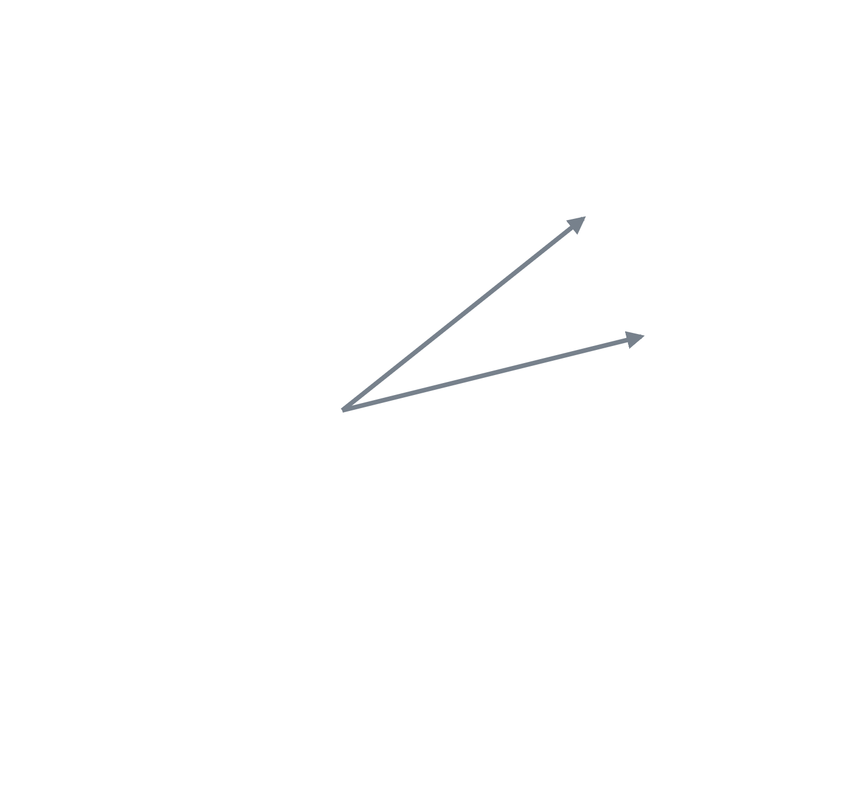

Pearson r across ROIs is a dot product of unit vectors
SETUP · STEP 1
Two odors, two unit vectors
Centre each odor’s response over ROIs and scale it to unit norm: x̂ᵢ = (xᵢ − x̄ᵢ 1) / ‖xᵢ − x̄ᵢ 1‖. One value per ROI, averaged over the time window.
A
θ
B
The correlation is the angle between them
rAB = ⟨x̂A, x̂B⟩ = cos θ = 0.91. That is the definition of Pearson correlation across ROIs, nothing added.
So everything that follows is plane geometry in ℝᴺ. The data live in ℝ⁶⁸⁹; six vectors in the plane carry the same argument.
Odor part, pair part · 5 · Setup
Section 2 of 6 · Setup
Notes:
Step 1: two grey unit vectors appear with the first card. Step 2: the angle and the second card. Step 3: the callout. The point of this slide is only that r is cos θ, so adding and subtracting vectors is allowed. The toy values are chosen so every number on the next slides matches the tables in the note.

Slide 6
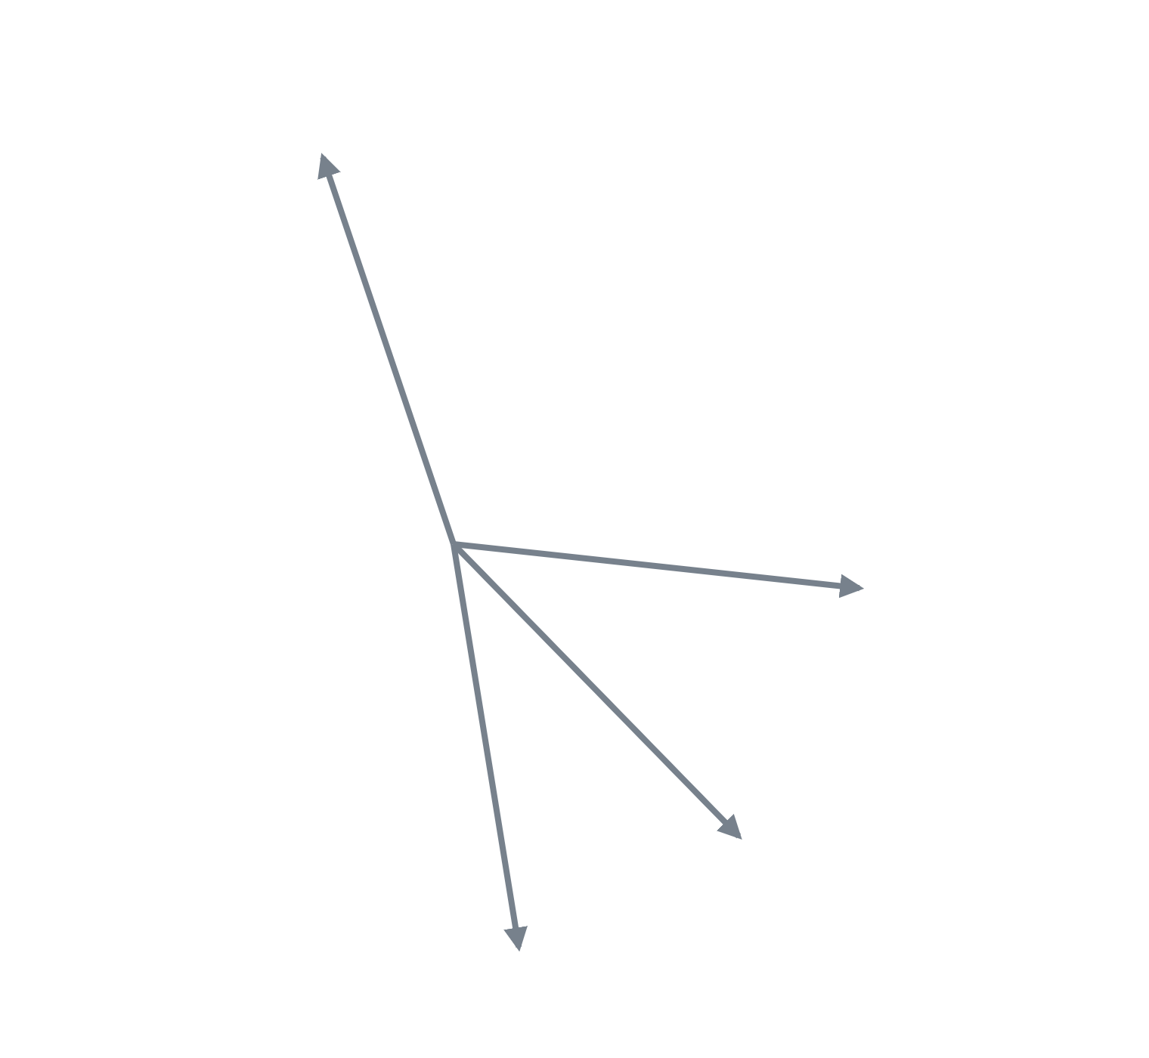
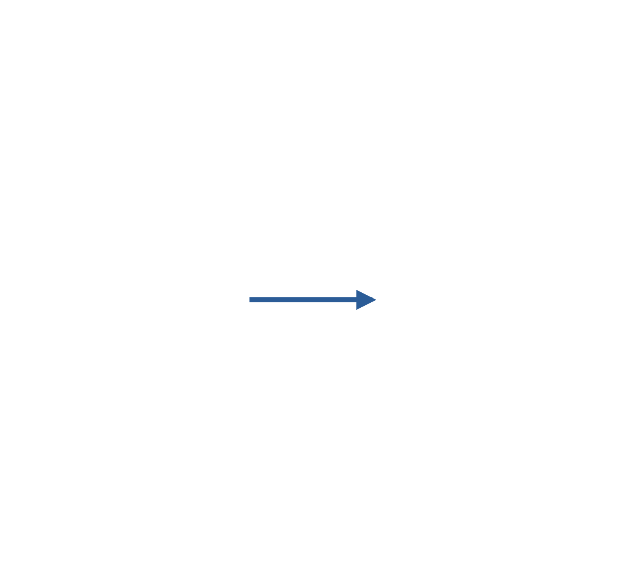
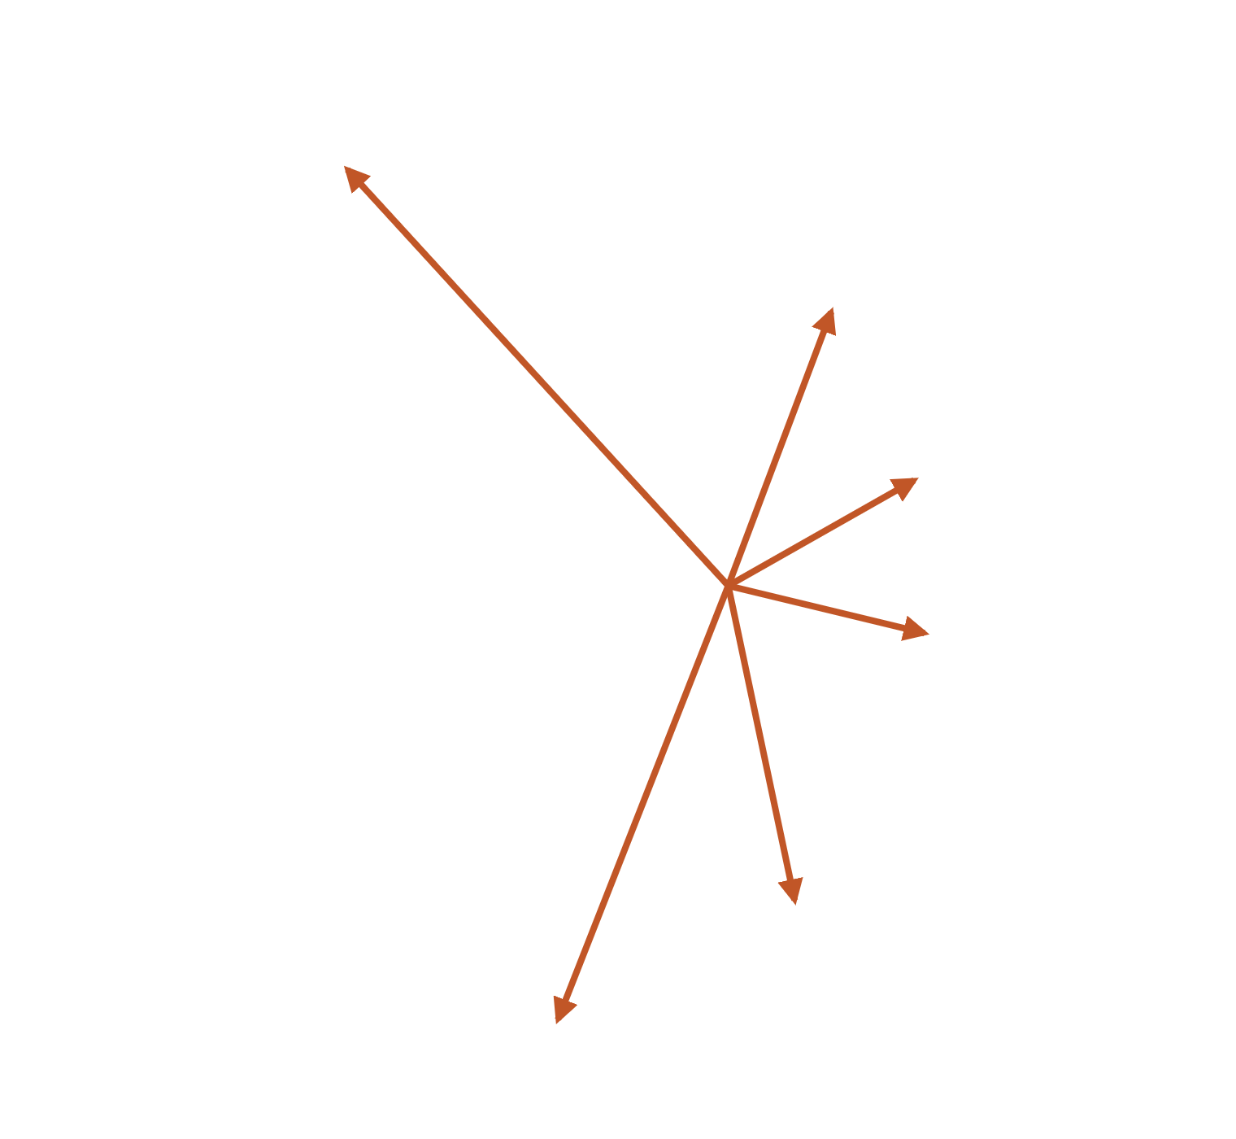
Each odor is the shared pattern m plus its own deviation dᵢ
SETUP · STEP 2
F
The whole panel
Six unit vectors stand in for the 17 odors. Grey: x̂ᵢ, one direction per odor. The circle is the unit sphere seen edge-on.
A
dF
dA
The mean direction m
dB
B
m = (1/n) Σᵢ x̂ᵢ, here with ‖m‖² = 0.30. It is the pattern all odors share: the panel-wide response profile. Averaged over all i, j, r̄ = ‖m‖² exactly.
dC
m
C
dD
dE
The deviations dᵢ
dᵢ = x̂ᵢ − m: what odor i does beyond the shared pattern. They sum to zero by construction, so x̂ᵢ = m + dᵢ with no remainder.
D
E
Odor part, pair part · 6 · Setup
Section 2 of 6 · Setup
Notes:
A and B carry over from the previous slide. Step 1 adds the other four odors. Step 2 grows m in blue; say that m is the mean of the unit vectors, so it is shorter than one. Step 3 draws every deviation from the tip of m in rust. If asked why the deviations sum to zero: because m is their mean, by definition.

Slide 7
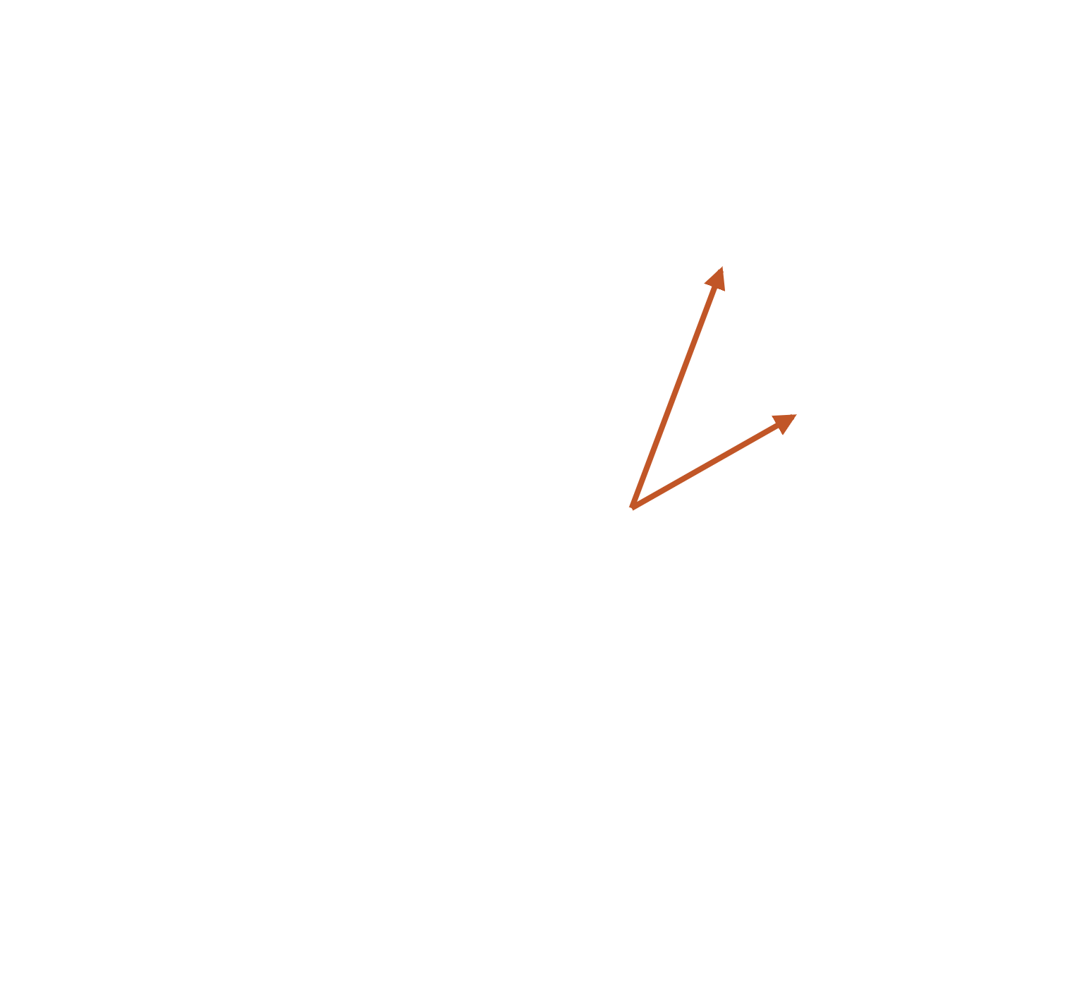

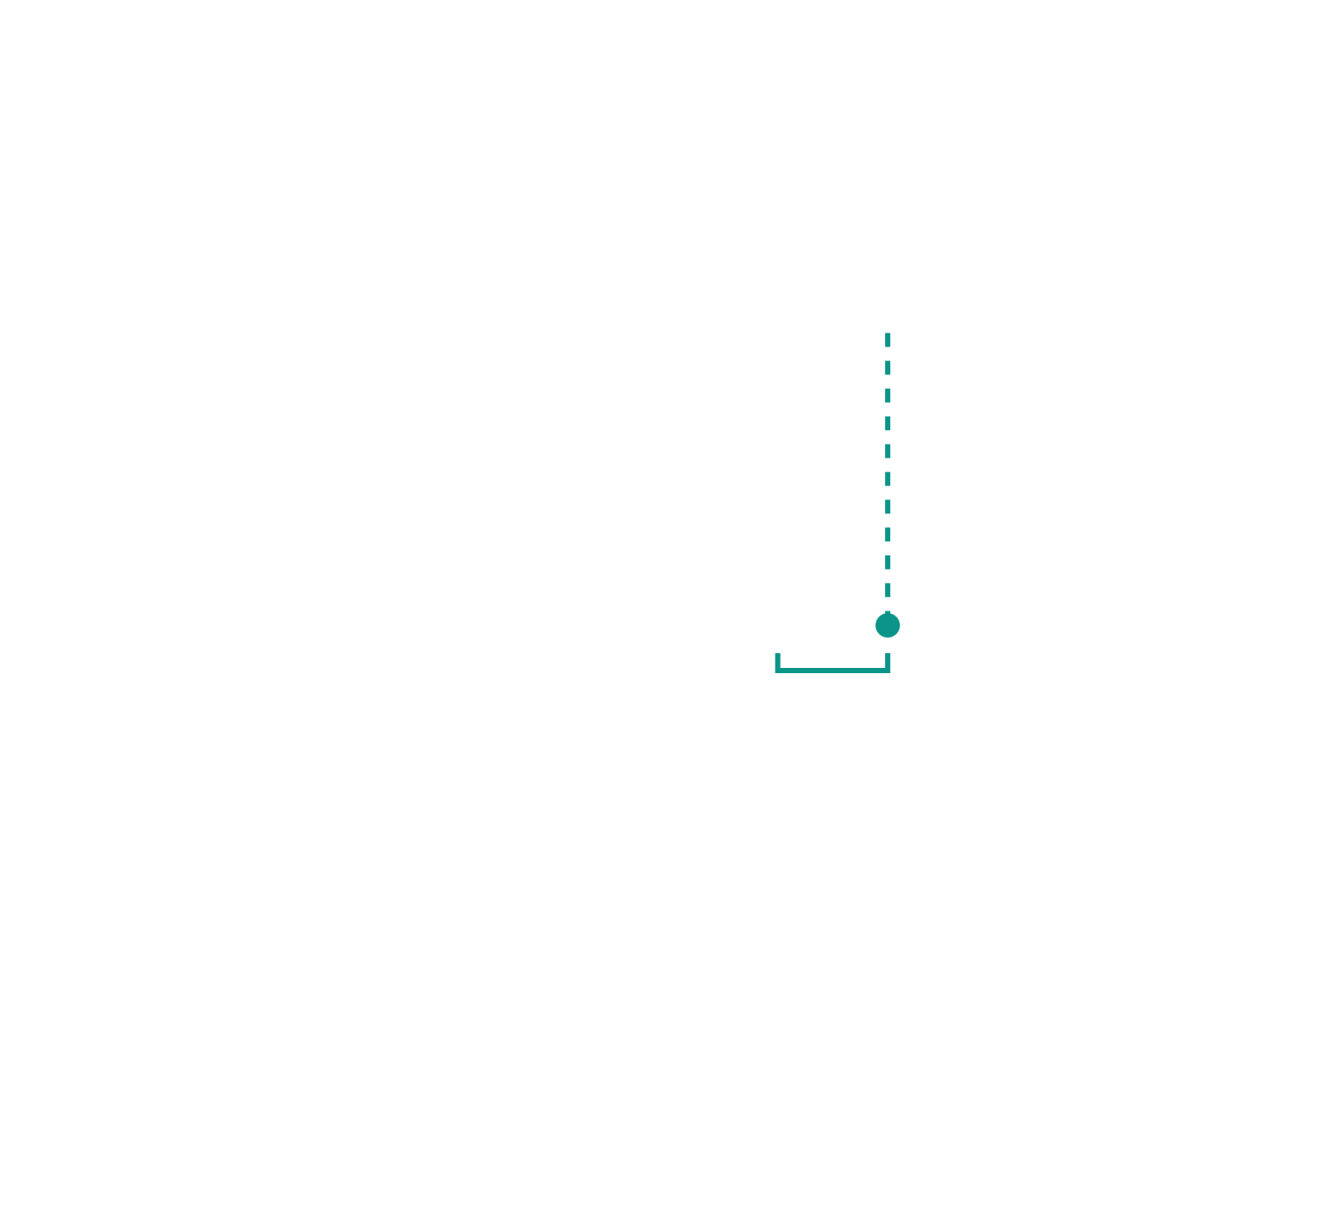
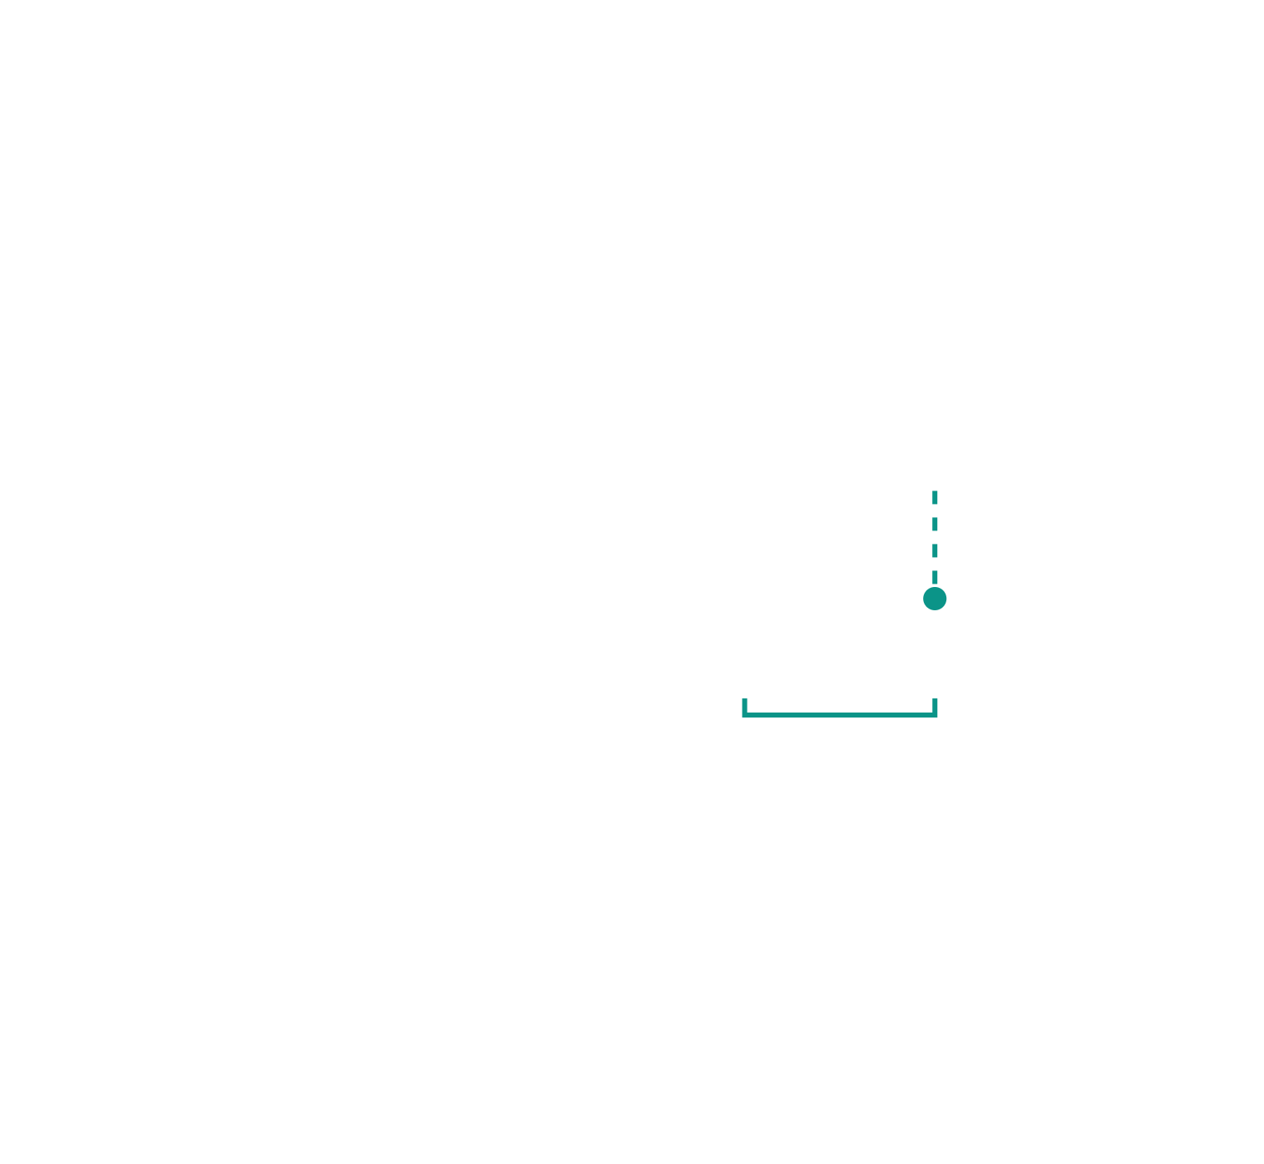
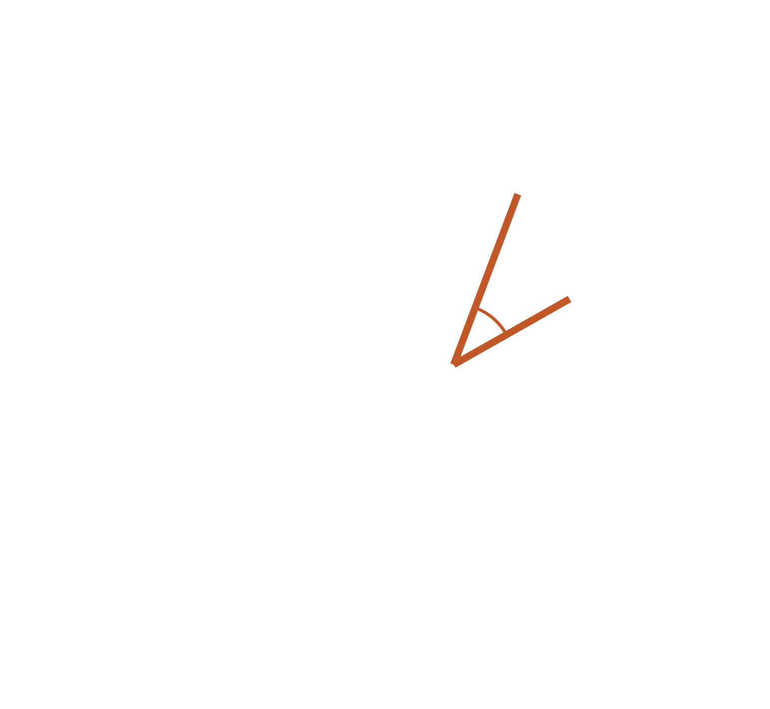
One correlation, four exact terms: rAB = 0.30 + 0.13 + 0.23 + 0.25
PROPOSITION 1
rAB = ⟨x̂A, x̂B⟩ = ⟨m + dA, m + dB⟩
‖m‖² = 0.30
the grand mean similarity, one constant for the whole panel
A
+ ⟨dA, m⟩ = 0.13
how far A leans toward the shared pattern: A’s odor value
dA
B
dB
+ ⟨dB, m⟩ = 0.23
how far B leans toward the shared pattern: B’s odor value
‖m‖²
⟨dA, m⟩
⟨dB, m⟩
+ ⟨dA, dB⟩ = 0.25
what A and B share once m is removed: the pair part
= 0.91. No approximation: the four terms are the expansion of a bilinear form in ℝᴺ.
Odor part, pair part · 7 · Proposition 1
Section 3 of 6 · Proposition 1
Notes:
Five steps. Step 1: the bracket under m is ‖m‖², the grand mean. Step 2: drop A onto the m axis; the teal bracket beyond the tip of m is ⟨dA, m⟩, because ⟨x̂A, m⟩ = ‖m‖² + ⟨dA, m⟩. Step 3: the same for B. Step 4: the angle between the two rust deviations is the pair part. Step 5: the sum. The proof is one line: substitute x̂ = m + d on both sides of the inner product and expand.

Slide 8
The three terms have exactly the roles the analysis gives them
PROPOSITION 1 · THE ROLES
‖m‖² is the grand mean
⟨dᵢ, m⟩ is the odor part
⟨dᵢ, dⱼ⟩ is the pair part
A single constant for the whole panel. Averaging the identity over all i, j (including i = j) and using Σᵢ dᵢ = 0 gives r̄ = ‖m‖² exactly.
Depends on odor i alone: how far its pattern leans toward the shared pattern. It is the row effect of the matrix: r̄ᵢ − r̄ = ⟨dᵢ, m⟩, with r̄ᵢ the mean of row i.
Depends on the pair: what the two patterns share once the shared pattern is removed. Its matrix B = DDᵀ has zero row sums, so it carries no odor-level signal by construction.
So “odor part” and “pair part” are not names for a curve fit. They are the additive and the interaction terms of an exact expansion of the Gram matrix of the response vectors, which is what double-centring a matrix computes.
Odor part, pair part · 8 · Proposition 1
Section 3 of 6 · Proposition 1
Notes:
The three cards build left to right, then the band. The row-effect identity is worth saying out loud: the mean of row i minus the grand mean is exactly ⟨dᵢ, m⟩, which is why least squares recovers it. The zero row sums of DDᵀ follow from Σ dᵢ = 0.

Slide 9
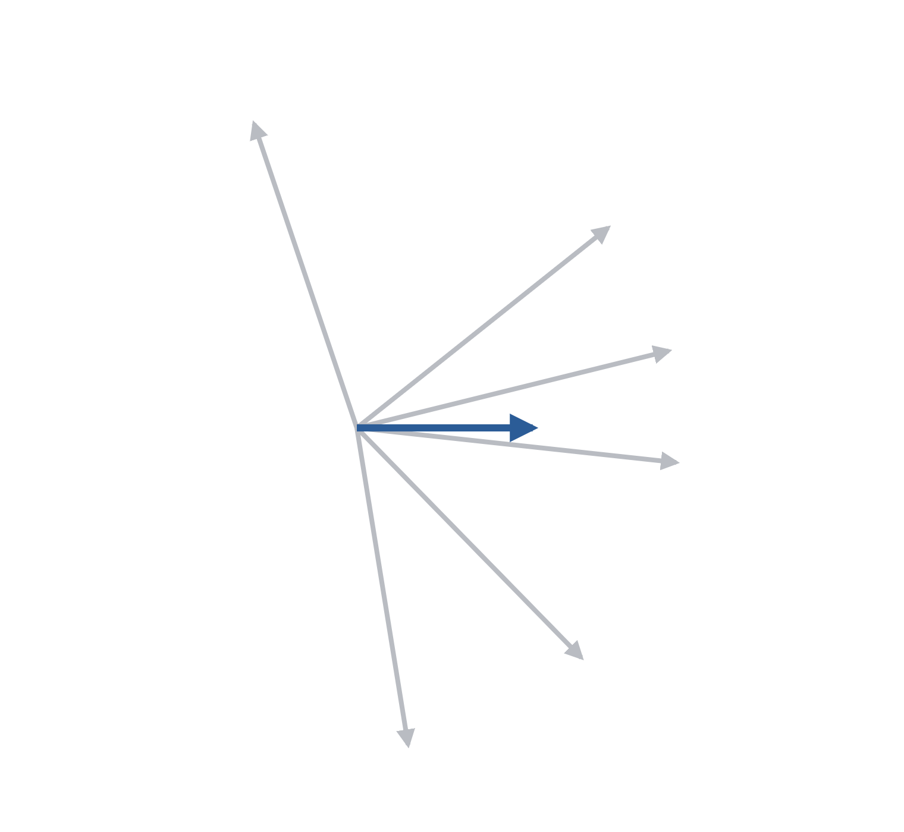
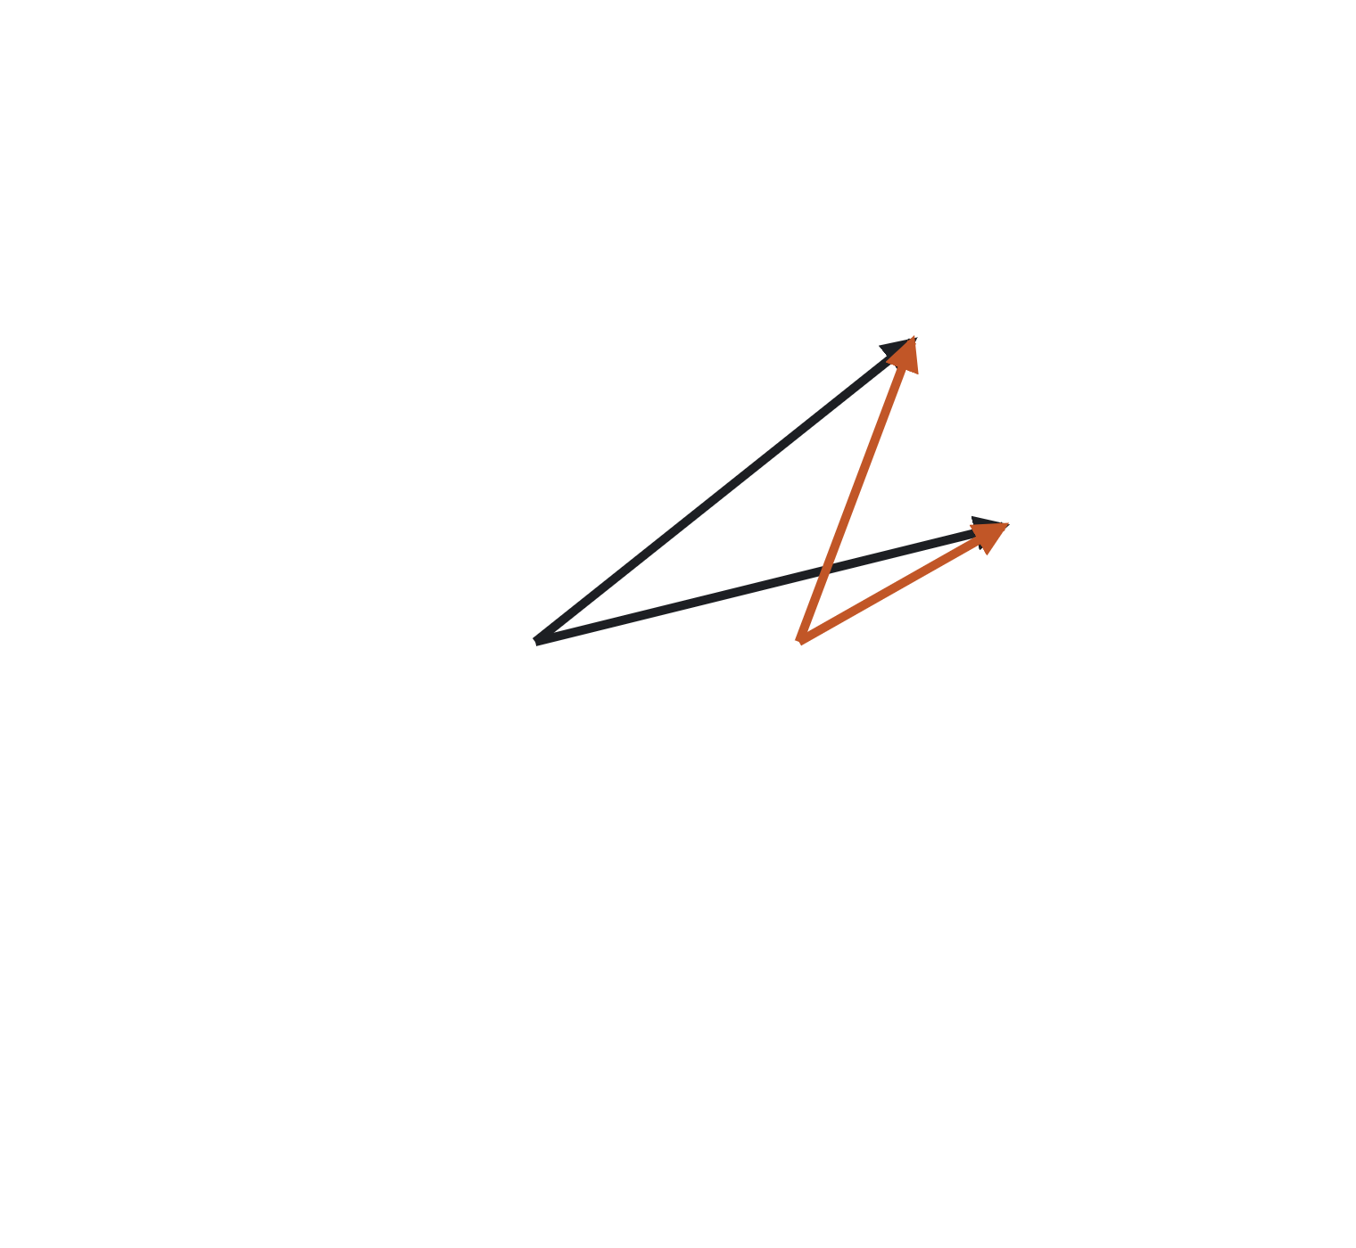
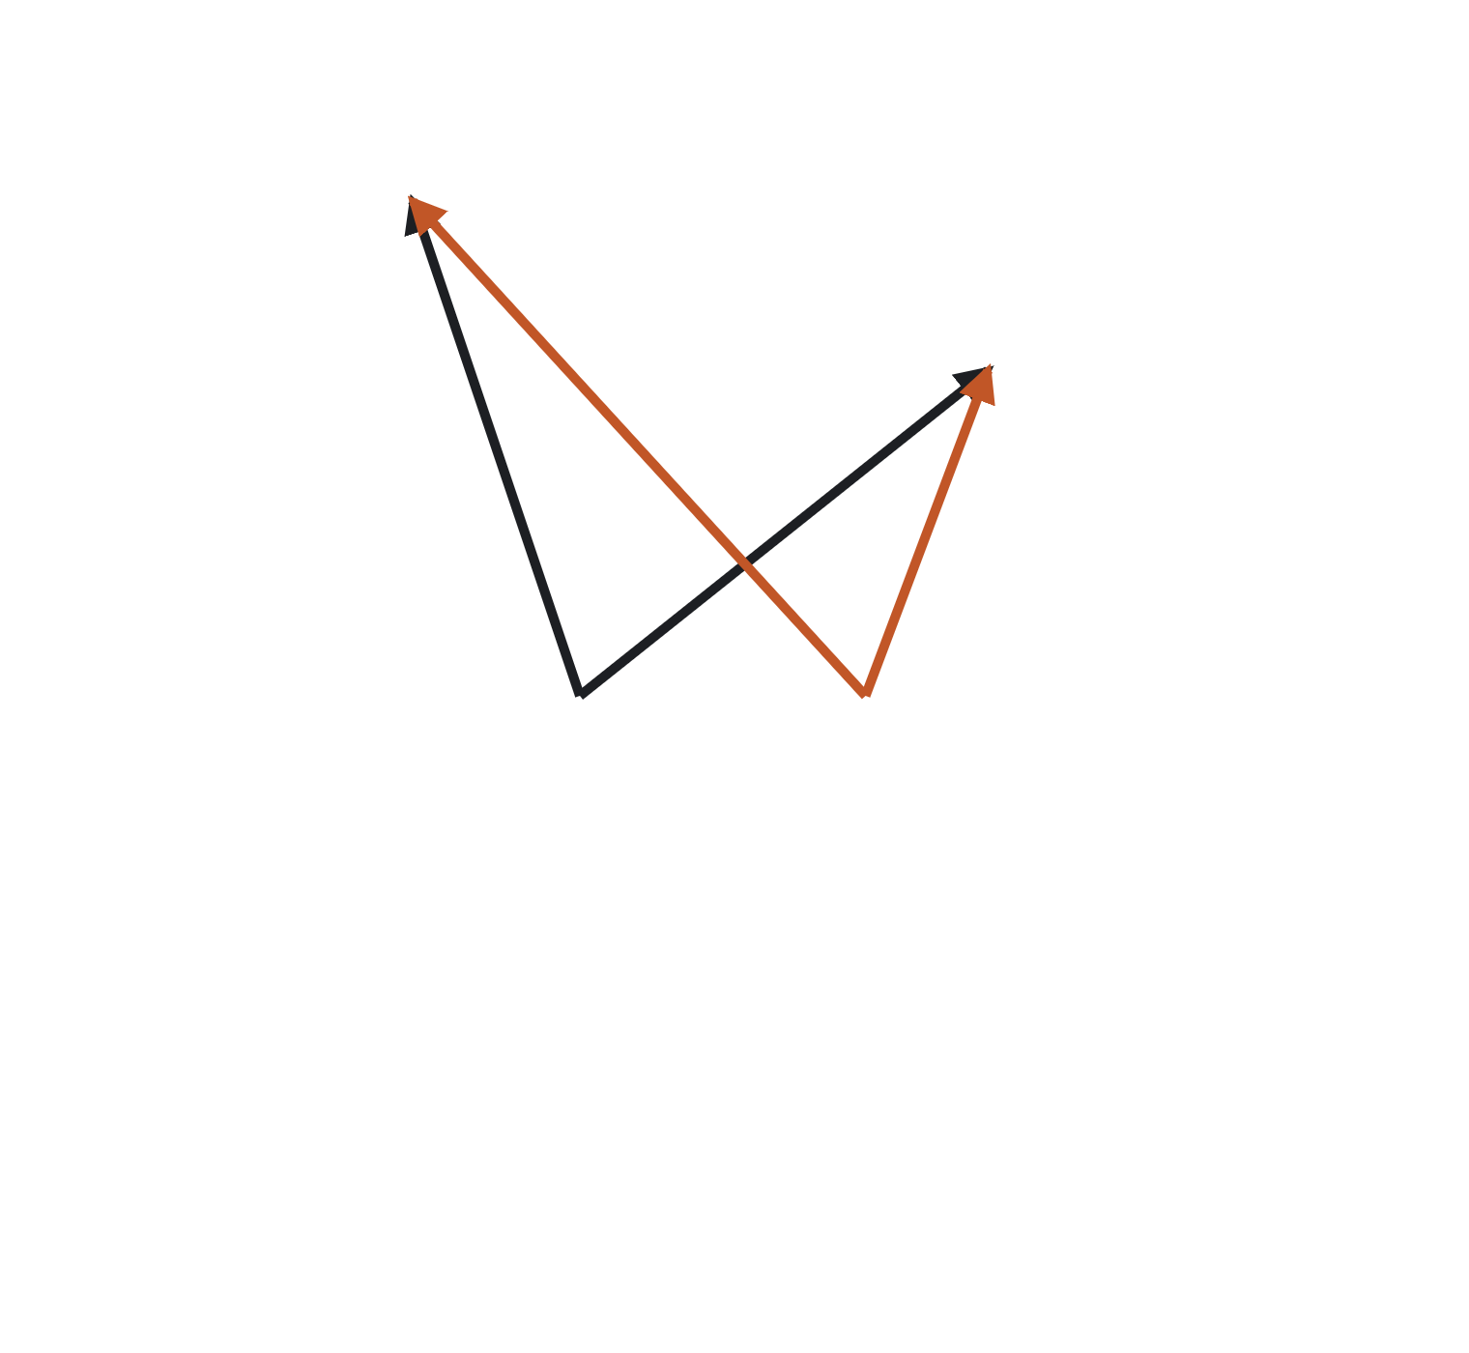
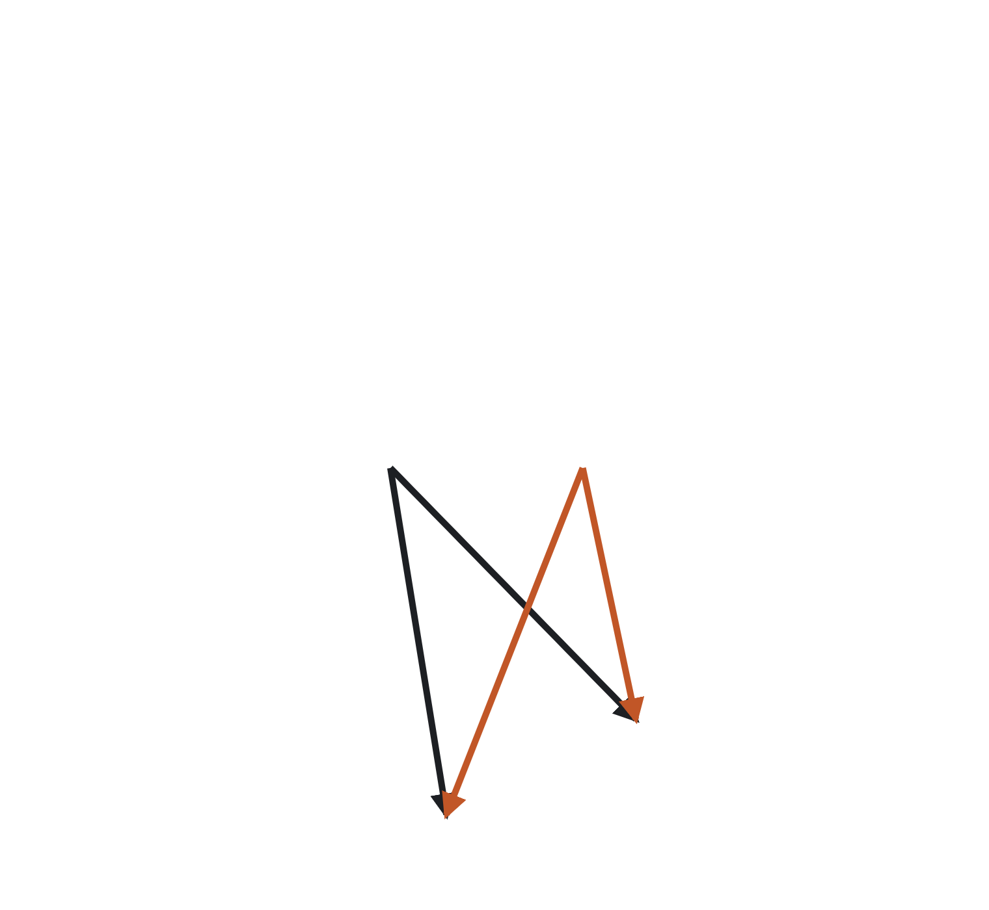
No: A and F are similar in a way the shared pattern does not explain at all
“Isn’t the pair part just whatever is left over?”
F
A–B · r = 0.91
+0.66 odor terms · +0.25 pair part
A
Similar mostly because both lean toward the shared pattern.
B
A–F · r = 0.34
−0.04 odor terms · +0.39 pair part
Both lean away from m, yet their deviations point the same way.
m
C
D–E · r = 0.82
+0.17 odor terms · +0.65 pair part
Likewise: a high correlation that the shared pattern barely touches.
D
Odor terms = ‖m‖² + ⟨dᵢ, m⟩ + ⟨dⱼ, m⟩ · pair part = ⟨dᵢ, dⱼ⟩ · same picture as artboard G of the decomposition toys
E
Odor part, pair part · 9 · Why it is real
Section 4 of 6 · Why it is real
Notes:
Three steps; each step highlights one pair on the figure (ink for the vectors, rust for the deviations) and reveals its row. Bars are to scale: 300 px per unit of r. The A–F row is the one to dwell on: a correlation of 0.34 with odor terms of about zero. The pair part is not a residual of a fit that failed; it is the geometry of the deviations.

Slide 10
The fitted odor values are ⟨dᵢ, m⟩ exactly, up to a factor 17/15 and a constant
PROPOSITION 2
The analysis does not double-centre the full matrix. It fits rᵢⱼ ≈ aᵢ + aⱼ by least squares on the 136 off-diagonal pairs only; the diagonal is a constant 1 and carries no information.
âᵢ = n/(n − 2) · ⟨dᵢ, m⟩ + c, with c the same for every odor
The proof is two lines
The factor and the constant
The pair part leaks a little
Setting ∂/∂aᵢ of Σᵢ<ⱼ (rᵢⱼ − aᵢ − aⱼ)² to zero gives (n − 2) aᵢ = Sᵢ − A, with Sᵢ = Σⱼ≠ᵢ rᵢⱼ. By Proposition 1, Sᵢ = n(‖m‖² + ⟨dᵢ, m⟩) − 1: everything but n⟨dᵢ, m⟩ is the same for every odor.
n = 17 gives 17/15 = 1.133. The constant c is irrelevant: the analysis only ever uses odor values after centring, in correlations, or as differences between conditions.
rᵢⱼ − âᵢ − âⱼ = ⟨dᵢ, dⱼ⟩ − 2/(n − 2) · (⟨dᵢ, m⟩ + ⟨dⱼ, m⟩) + c′. The leak, 0.13 of the odor values, is additive in i and j, so it cannot create pair-specific structure. Toy correlation with ⟨dᵢ, dⱼ⟩: 0.995. Fitting with the diagonal included removes it.
Odor part, pair part · 10 · Propositions 2 and 3
Section 5 of 6 · Propositions 2 and 3
Notes:
Four steps: the result, then the proof, the factor, the leak. Summing the normal equations over i fixes A = (Σᵢ<ⱼ rᵢⱼ)/(n − 1), a constant. The leak is the one place where the off-diagonal fit differs from double-centring; it slightly shrinks the contrast between odor values that the pair part is measured against, nothing more.

Slide 11
The residual case inherits the same meaning, because every step is linear
“But Figure 7 decomposes a residual, not a correlation matrix.”
“Claws beyond E[claws | boutons]”: z-score each matrix’s 136 off-diagonal entries, regress z(claws) on z(boutons), keep the residual. Both steps are affine maps of the entries, and the least-squares fit is a linear operator L on the 136 entries.
uᵢⱼ = (rᶜᵢⱼ − μᶜ)/σᶜ − β · (rᵇᵢⱼ − μᵇ)/σᵇ
⟹ âᵢ(u) = n/(n − 2) · [ ⟨dᶜᵢ, mᶜ⟩/σᶜ − β · ⟨dᵇᵢ, mᵇ⟩/σᵇ ] + c
What the odor value means now
What the pair part means now
How far the claw pattern for odor i leans toward the claws’ shared pattern, minus β times how far the bouton pattern leans toward the boutons’ shared pattern, each in its matrix’s own z units. The odor-part drift over time is a drift in this quantity.
The claw ⟨dᶜᵢ, dᶜⱼ⟩ minus β times the bouton ⟨dᵇᵢ, dᵇⱼ⟩, likewise scaled: L of a constant vector is a constant odor value, so (I − L)u splits the same way. A change in one odor’s amplitude reaches neither part; a change in its reliability reaches the pair part.
Odor part, pair part · 11 · Propositions 2 and 3
Section 5 of 6 · Propositions 2 and 3
Notes:
Four steps. The proof: for u = α rᶜ + γ rᵇ + const, L u = α L rᶜ + γ L rᵇ + L const, and L of a constant is a constant odor value; apply Proposition 2 to each term. Reliability matters because noise multiplies rᵢⱼ by the square root of relᵢ relⱼ, which is not additive; that is why the analysis disattenuates. Pearson r is scale-free in xᵢ, so amplitude cannot reach either part.

Slide 12
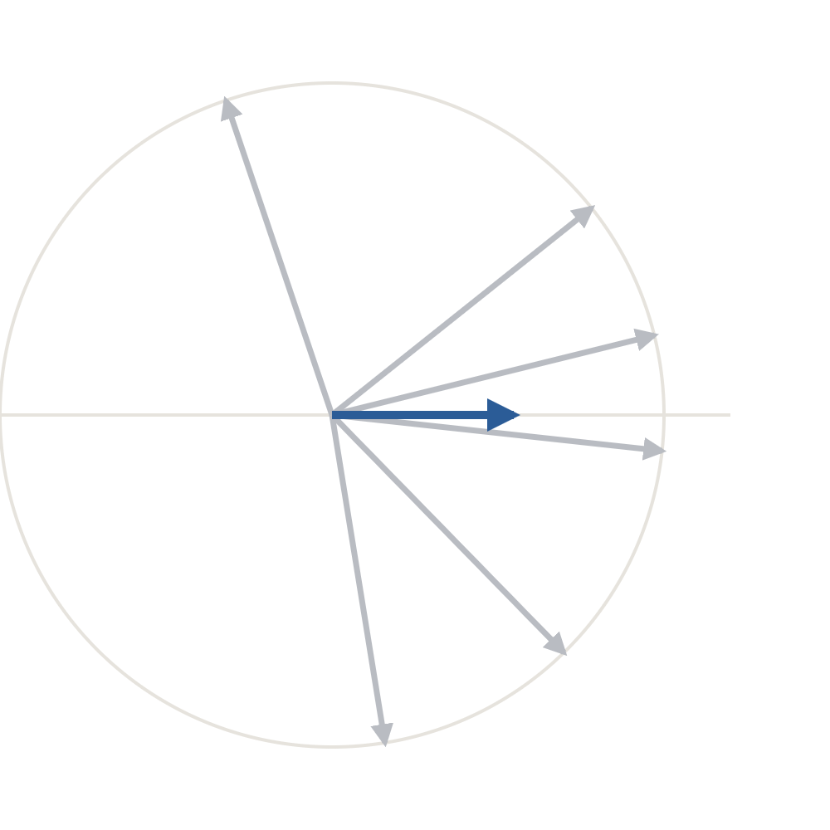
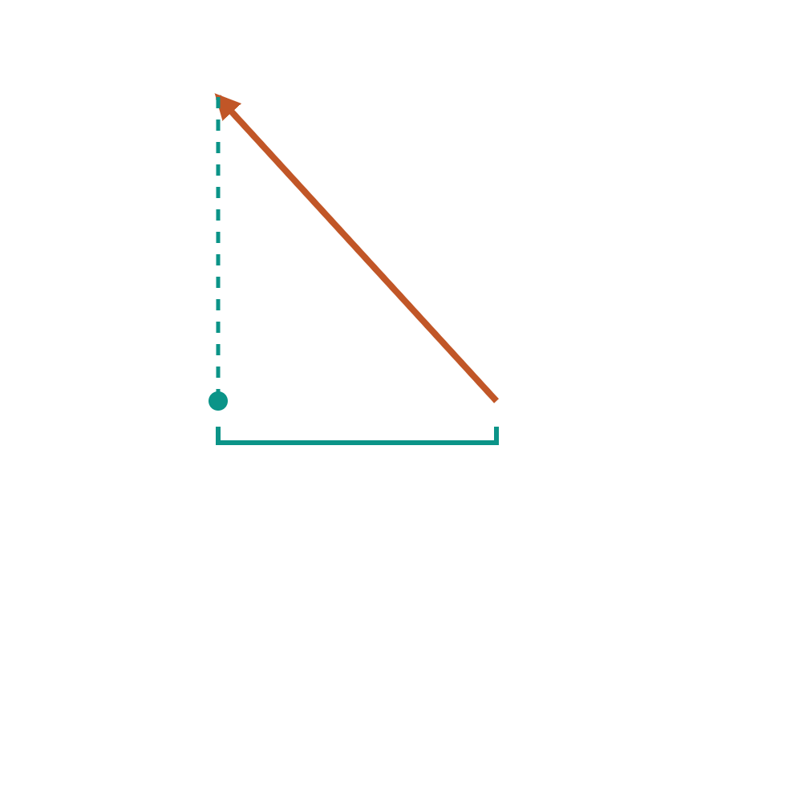
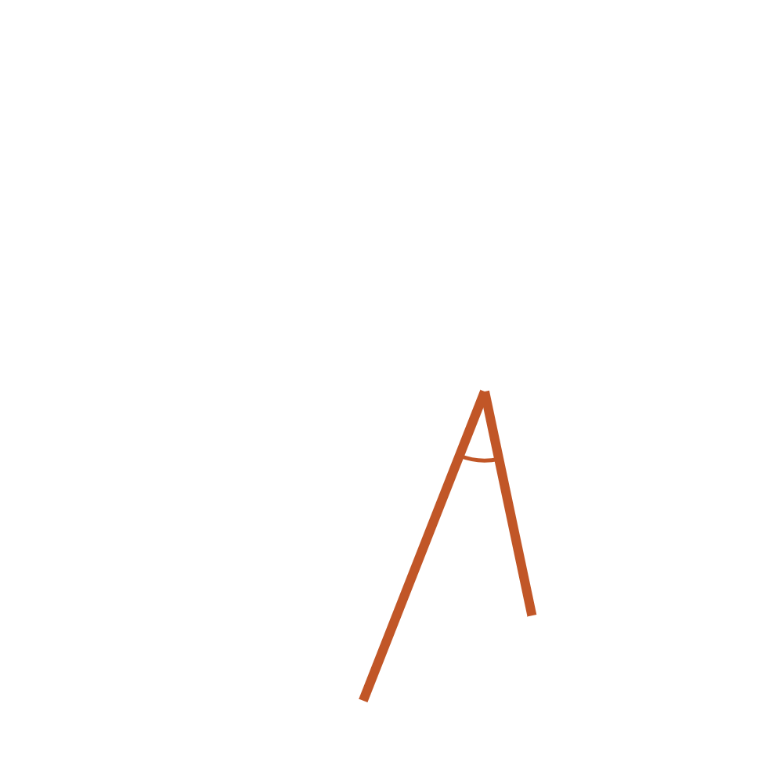
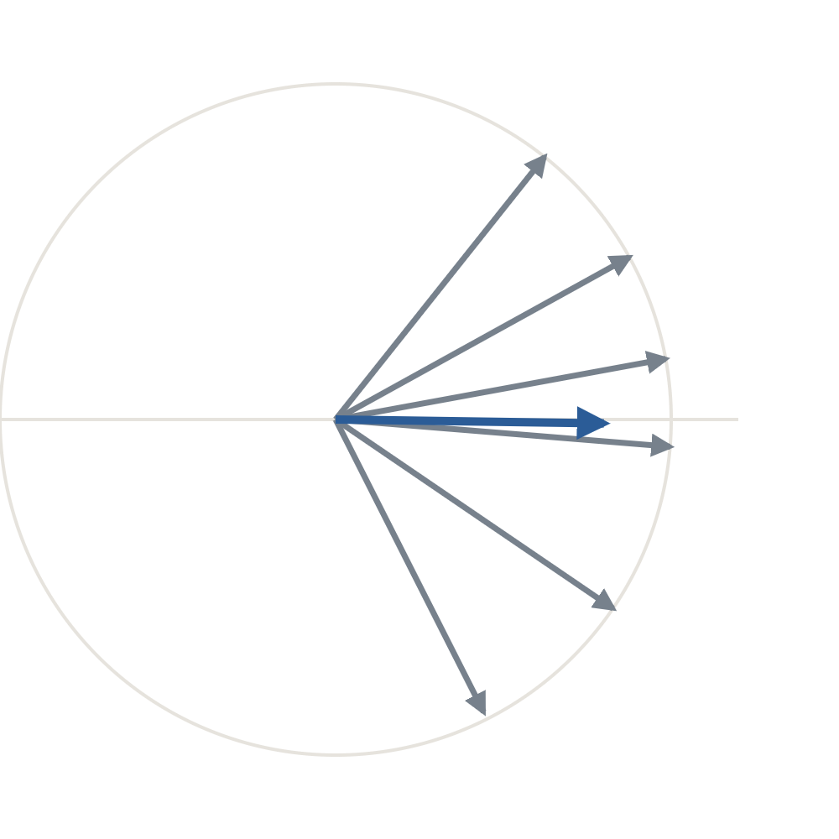
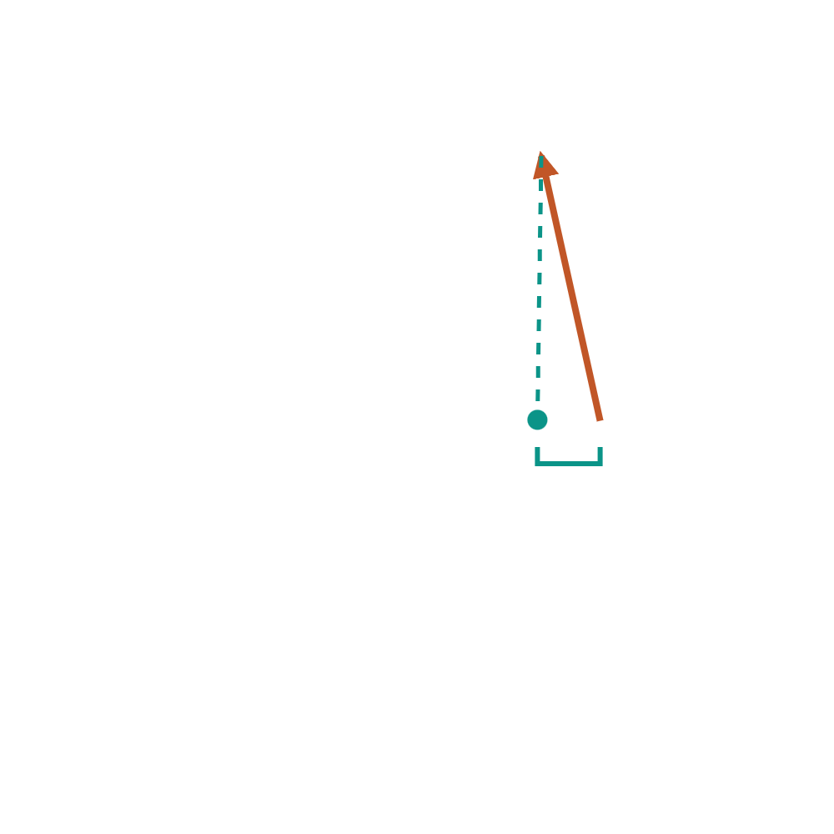
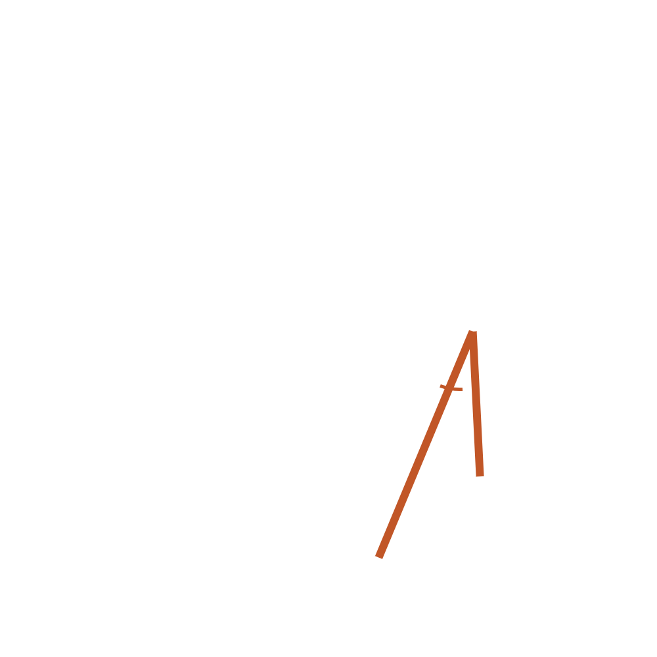
The same geometry at both stages; the residual is one minus β times the other
PROPOSITION 3 · THE PICTURE
Boutons · ‖m‖² = 0.30
Claws · ‖m‖² = 0.64
F
Odor value of F in u
F
Claw bracket in claw z units: −0.15 / 0.39 = −0.39. β times the bouton bracket in bouton z units: 0.90 × (−0.48 / 0.62) = −0.69. Difference +0.30; fitted âF = +0.45 = (6/4) × 0.30. F leans toward the shared pattern more than the boutons predict.
A
A
B
B
m
m
C
C
⟨dF, m⟩ = −0.48
⟨dF, m⟩ = −0.15
⟨dD, dE⟩ = 0.65
⟨dD, dE⟩ = 0.47
Pair part of D–E in u
D
Claw angle term 0.47 / 0.39 = 1.20; β times the bouton term 0.90 × 0.65 / 0.62 = 0.94. Difference +0.26; fitted e = +0.42 with the n = 6 leak. D and E share more beyond m than the boutons predict.
D
E
E
Same six odors at two stages. Claws: every odor pulled a quarter of the way toward m, and F swung a further 30° toward it. u = z(claw r) − β z(bouton r), with β = 0.90, σᵇ = 0.62, σᶜ = 0.39.
Nothing new is measured: each part of u is a claw quantity minus β times the same bouton quantity. The regression only sets β and the two z units.
Odor part, pair part · 12 · Propositions 2 and 3
Section 5 of 6 · Propositions 2 and 3
Notes:
Two pauses. Left panel: the bouton toy from slide 6. Right panel: the same odors at the claws — all pulled toward m (the compression), F also swung 30° toward m. Pause 1: F’s deviation and its teal bracket in both panels; the residual odor value is the claw bracket (in claw z units) minus β times the bouton bracket (in bouton z units): −0.39 − (−0.69) = +0.30, and the fit returns 1.5 × that because n = 6. Pause 2: the D–E deviations and the angle between them in both panels; the residual pair part is the same difference of ⟨dD, dE⟩ terms. The point of the slide is that the residual never leaves the vector picture: it is the geometry at one stage minus the scaled geometry at the other. In the data the two σ’s and β come from the 136 off-diagonal entries; here they come from the 15.

Slide 13
On a synthetic 17 × 400 panel, every equality holds to floating-point precision
NUMERIC CHECK
Claim | Check | Result
Proposition 1: four-term identity | max over 136 pairs of |rᵢⱼ − (‖m‖² + ⟨dᵢ, m⟩ + ⟨dⱼ, m⟩ + ⟨dᵢ, dⱼ⟩)| | 2.8 × 10⁻¹⁶
Pair matrix DDᵀ has zero row sums | max row sum | 3.3 × 10⁻¹⁶
Proposition 2: fitted aᵢ vs ⟨dᵢ, m⟩ | correlation; slope | 1.000; 1.1333 = 17/15
Pair part vs ⟨dᵢ, dⱼ⟩ | correlation | 0.993
Pair part vs ⟨dᵢ, dⱼ⟩ with the 2/(n − 2) leak term | max absolute difference | 3.2 × 10⁻¹⁶
Proposition 3: residual odor values | vs (1/σᶜ)⟨dᶜᵢ, mᶜ⟩ − (β/σᵇ)⟨dᵇᵢ, mᵇ⟩: correlation; slope | 1.000; 1.1333
17 odors × 400 ROIs, shared component plus independent noise, seed 7, run through the analysis code’s own off-diagonal least-squares fit. The six lines that matter: centre and normalise the rows, m = mean of rows, D = rows − m, compare R with ‖m‖² + Dm1ᵀ + 1(Dm)ᵀ + DDᵀ.
Odor part, pair part · 13 · Check and limits
Section 6 of 6 · Check and limits
Notes:
The check script is the generator behind the decomposition toy canvas, make_decomposition_toys.py, pending sync to code/explainers/. The 0.993 row is the raw pair part against ⟨dᵢ, dⱼ⟩; the next row shows that once the known leak term is added the match is exact.

Slide 14
The identity settles what the parts are, not how to read them
CAVEATS
m is the panel’s mean, not a property of the circuit
Pearson r discards amplitude and sparseness per odor
⟨dᵢ, m⟩ measures odor i against the 17 odors that happened to be delivered. Add or drop an odor and m moves, so every odor value moves a little. The leave-one-odor-out jackknife measures exactly this sensitivity.
Normalising to unit norm removes how strongly odor i drives the population; an odor that recruits many ROIs weakly and one that recruits few strongly can share an x̂ᵢ. The odor part is pattern geometry only; drive is measured separately, from amplitudes.
Noise enters multiplicatively and leaks into the pair part
The pair part is not a “clean” interaction term
Observed rᵢⱼ ≈ true rᵢⱼ × √(relᵢ relⱼ), which is not additive in i and j, so unequal reliabilities put spurious structure into ⟨dᵢ, dⱼ⟩ (toy E). Hence disattenuation by measured reliability, the odor-label permutation and the split-fly instrument check.
It is everything that is not additive: cluster structure, acetate-versus-ester contrasts and pair-specific noise alike. The analysis never interprets the pair part as a whole, only specific contrasts within it, each with its own permutation test.
Odor part, pair part · 14 · Check and limits
Section 6 of 6 · Check and limits
Notes:
Four cards, one per step. Say the first before anyone raises it: the odor values are relative to this panel. The third is the one that matters for the stability claims; the disattenuation and the two instrument checks exist because of it.

Slide 15
The proof, the picture and the check are each one click away
WHERE EVERYTHING LIVES
The note
The toy canvas and the animation
The code
“Odor-part / pair-part decomposition: what it is in the response vectors”. The three propositions with proofs, the picture, and the numeric-check table this deck follows.
make_decomposition_toys.py generates the canvas and runs the check; pending sync to code/explainers/. The vectors in this deck are solved so every displayed number matches the note’s tables.
Artboard G of the decomposition toys is the six-vector picture; toy E shows the reliability leak. The two-minute manim rendering of the same geometry sits beside this deck.
Toy geometry: ‖m‖² = 0.30 · ⟨x̂ᵢ, m⟩ = +0.42, +0.53, +0.54, +0.38, +0.08, −0.18 for A–F · rAB = 0.91, rAF = 0.34, rDE = 0.82
Odor part, pair part · 15 · Check and limits
Section 6 of 6 · Check and limits
Notes:
Close by pointing at the note for anyone who wants the algebra, and at artboard G for anyone who wants to move the vectors themselves. Questions on interpretation go back to the caveats slide, not to the propositions.

Slide 16
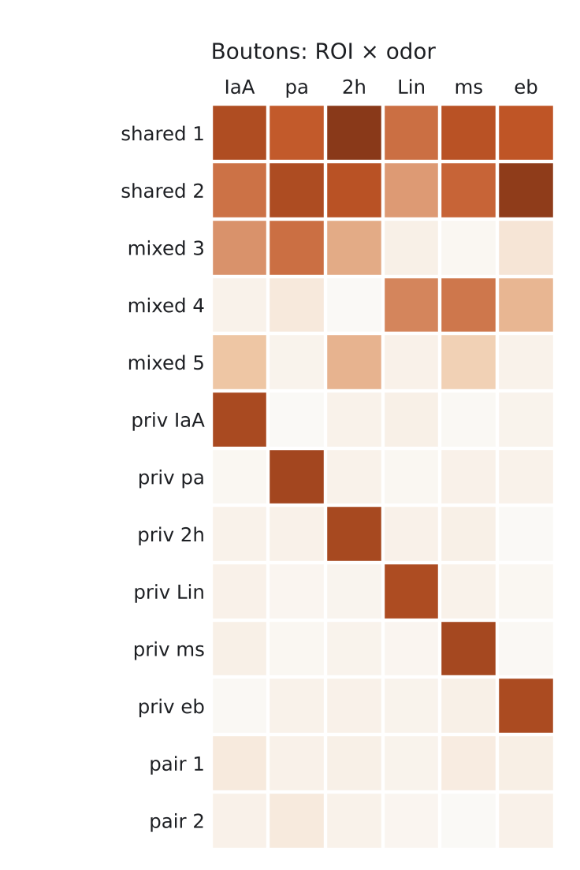
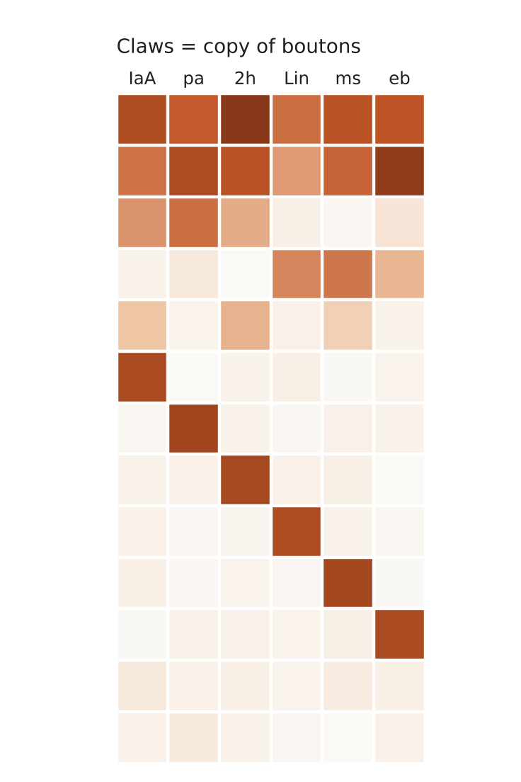
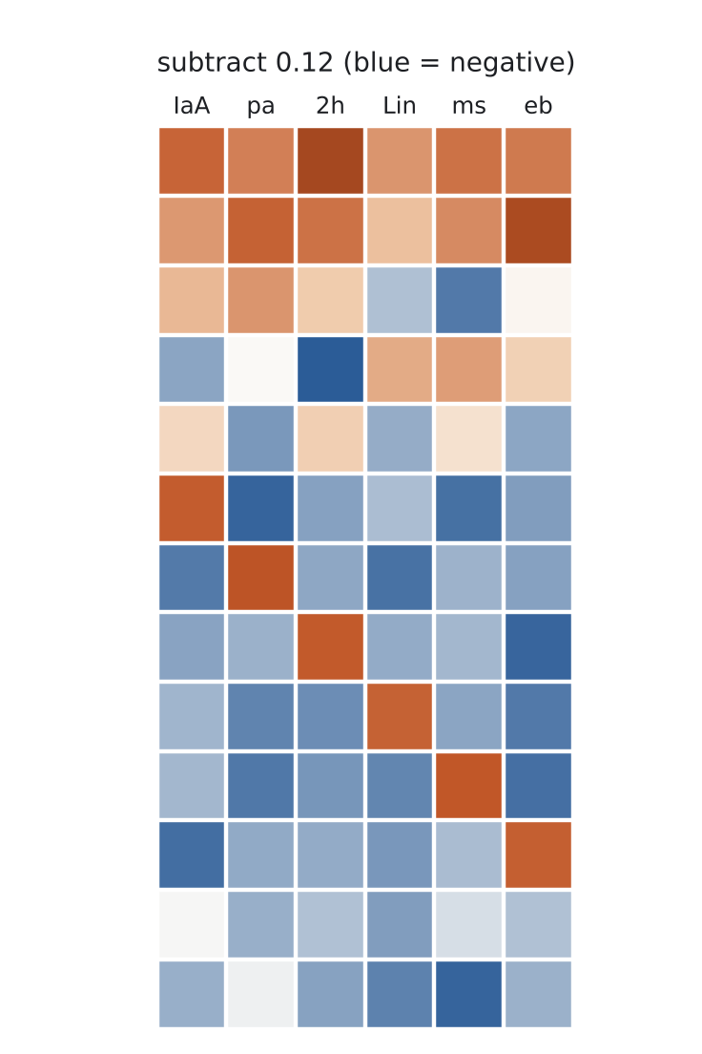
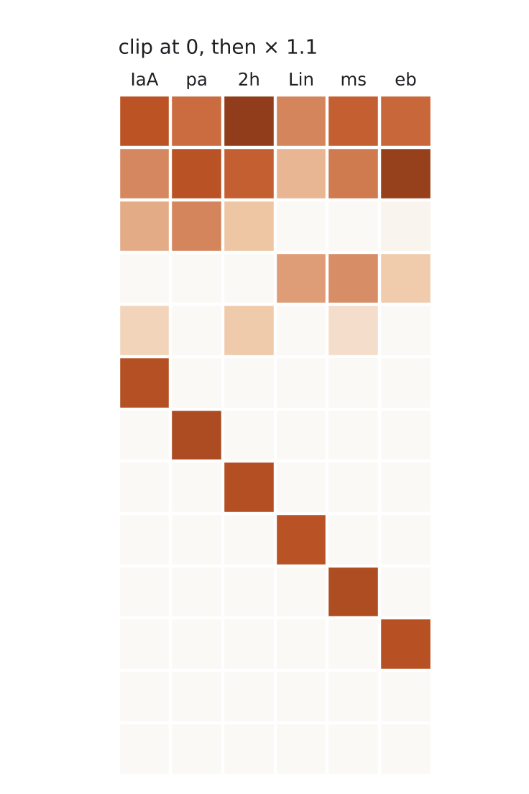
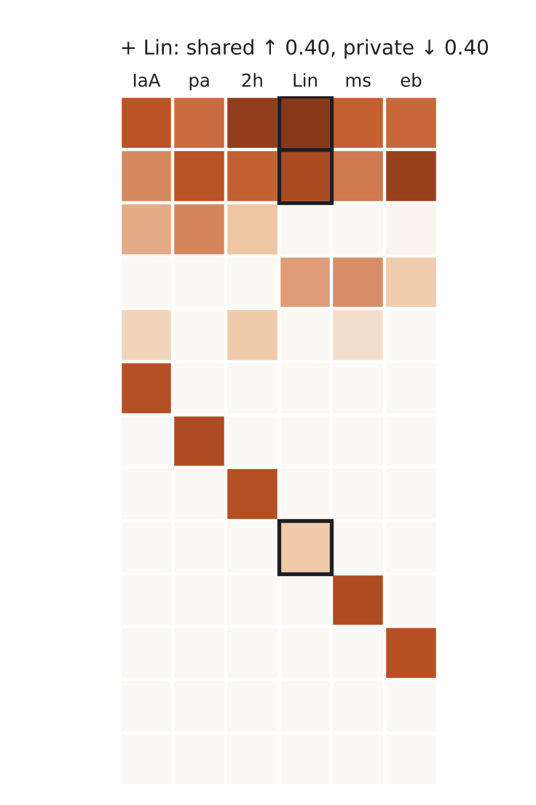
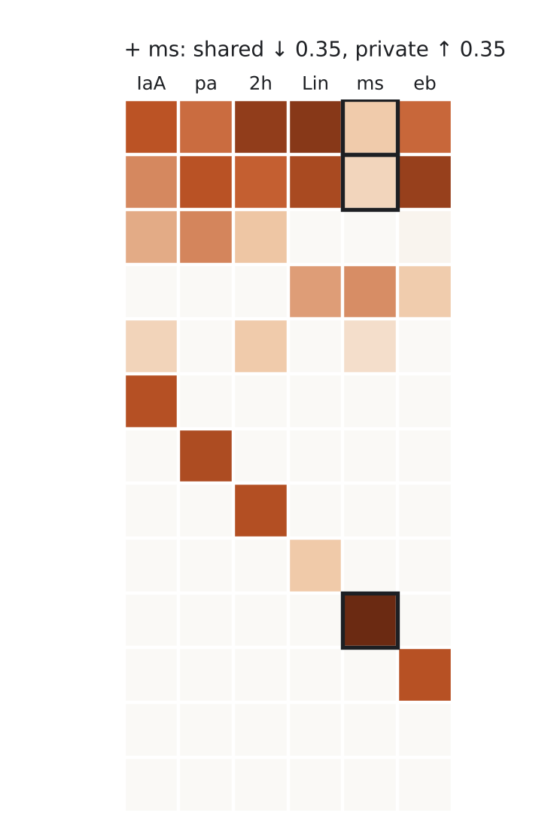
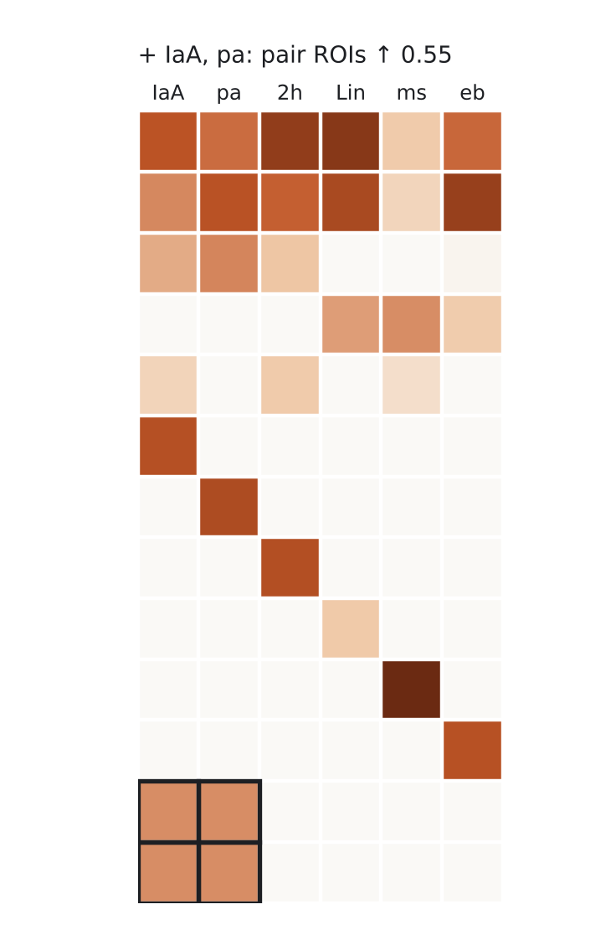
Six odors, two stages: claws copy boutons, with three shifts planted on the way
APPENDIX · A TOY PATHWAY
Odor-part shift, positive: Lin
Gains response in the two ROIs every odor drives, loses its private response. Its vector swings toward the cloud’s common direction, so its r with every odor rises by a similar amount: aLin > 0.
Odor-part shift, negative: ms
The reverse: loses shared response, gains private response. Its vector swings away from the common direction and its r with everything falls: ams < 0. A reliability loss would look the same.
Pair-part shift: IaA and pa
Both gain response in two ROIs nothing else drives, so both swing toward that private axis together: r(IaA, pa) rises far more than their r with anything else, e(IaA, pa) > 0.
13 ROIs × 6 odors. The claw panel builds in five steps: copy of boutons → subtract 0.12 → clip at 0 and ×1.1 → the three planted shifts, outlined.
Odor part, pair part · 16 · Appendix
Appendix · A toy pathway with planted shifts
Notes:
Five clicks. Before any click: boutons on the left, claws on the right as an exact copy. Click 1: subtract 0.12 from every response; the blue cells are what has gone negative, mostly private ROIs of other odors and the near-silent pair ROIs. Click 2: clip at 0 and scale by 1.1 — this is the thresholded copy that E[claws | boutons] will later predict; nothing odor-specific has happened yet. Click 3: Lin +0.40 in both shared ROIs, −0.40 in its private ROI, and the Lin card. Click 4: ms −0.35 shared, +0.35 private, and the ms card. Click 5: IaA and pa +0.55 in both pair ROIs, and the pair card. Boutons have small uniform jitter (seed 3) so no two columns are identical.

Slide 17
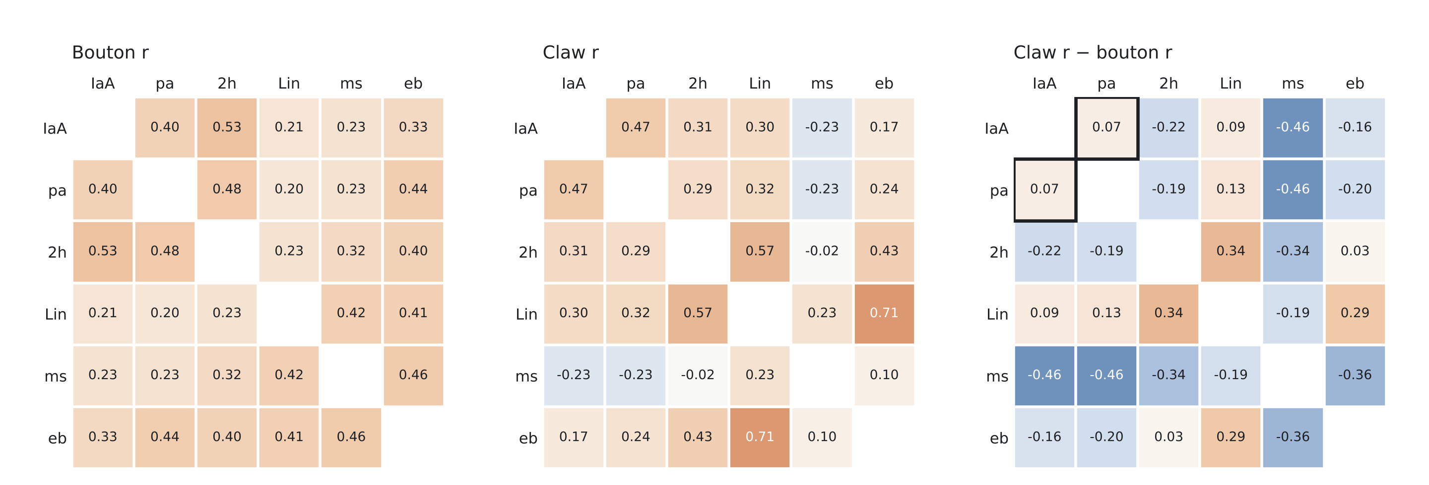
In the raw difference, ms is obvious, Lin is muddled, and the planted pair shift is almost invisible
APPENDIX · THE CORRELATION MATRICES
Pearson r across ROIs at each stage, and claw r − bouton r. The ms row falls everywhere (−0.19 to −0.46); the Lin row rises with 2h and eb but not with IaA or pa; and r(IaA, pa) moves by only +0.07 (outlined), because the threshold step lowers most claw correlations at once.
Odor part, pair part · 17 · Appendix
Appendix · A toy pathway with planted shifts
Notes:
This is the slide that motivates the regression step. The raw difference mixes three things: the global change from the threshold (every correlation that depended on the shared ROIs drops), the two odor-part plants, and the pair plant. Looking at the difference matrix alone you would call ms and probably miss IaA–pa entirely. The planted IaA–pa change is +0.07 in raw r while unrelated entries move by −0.2 to −0.5.

Slide 18
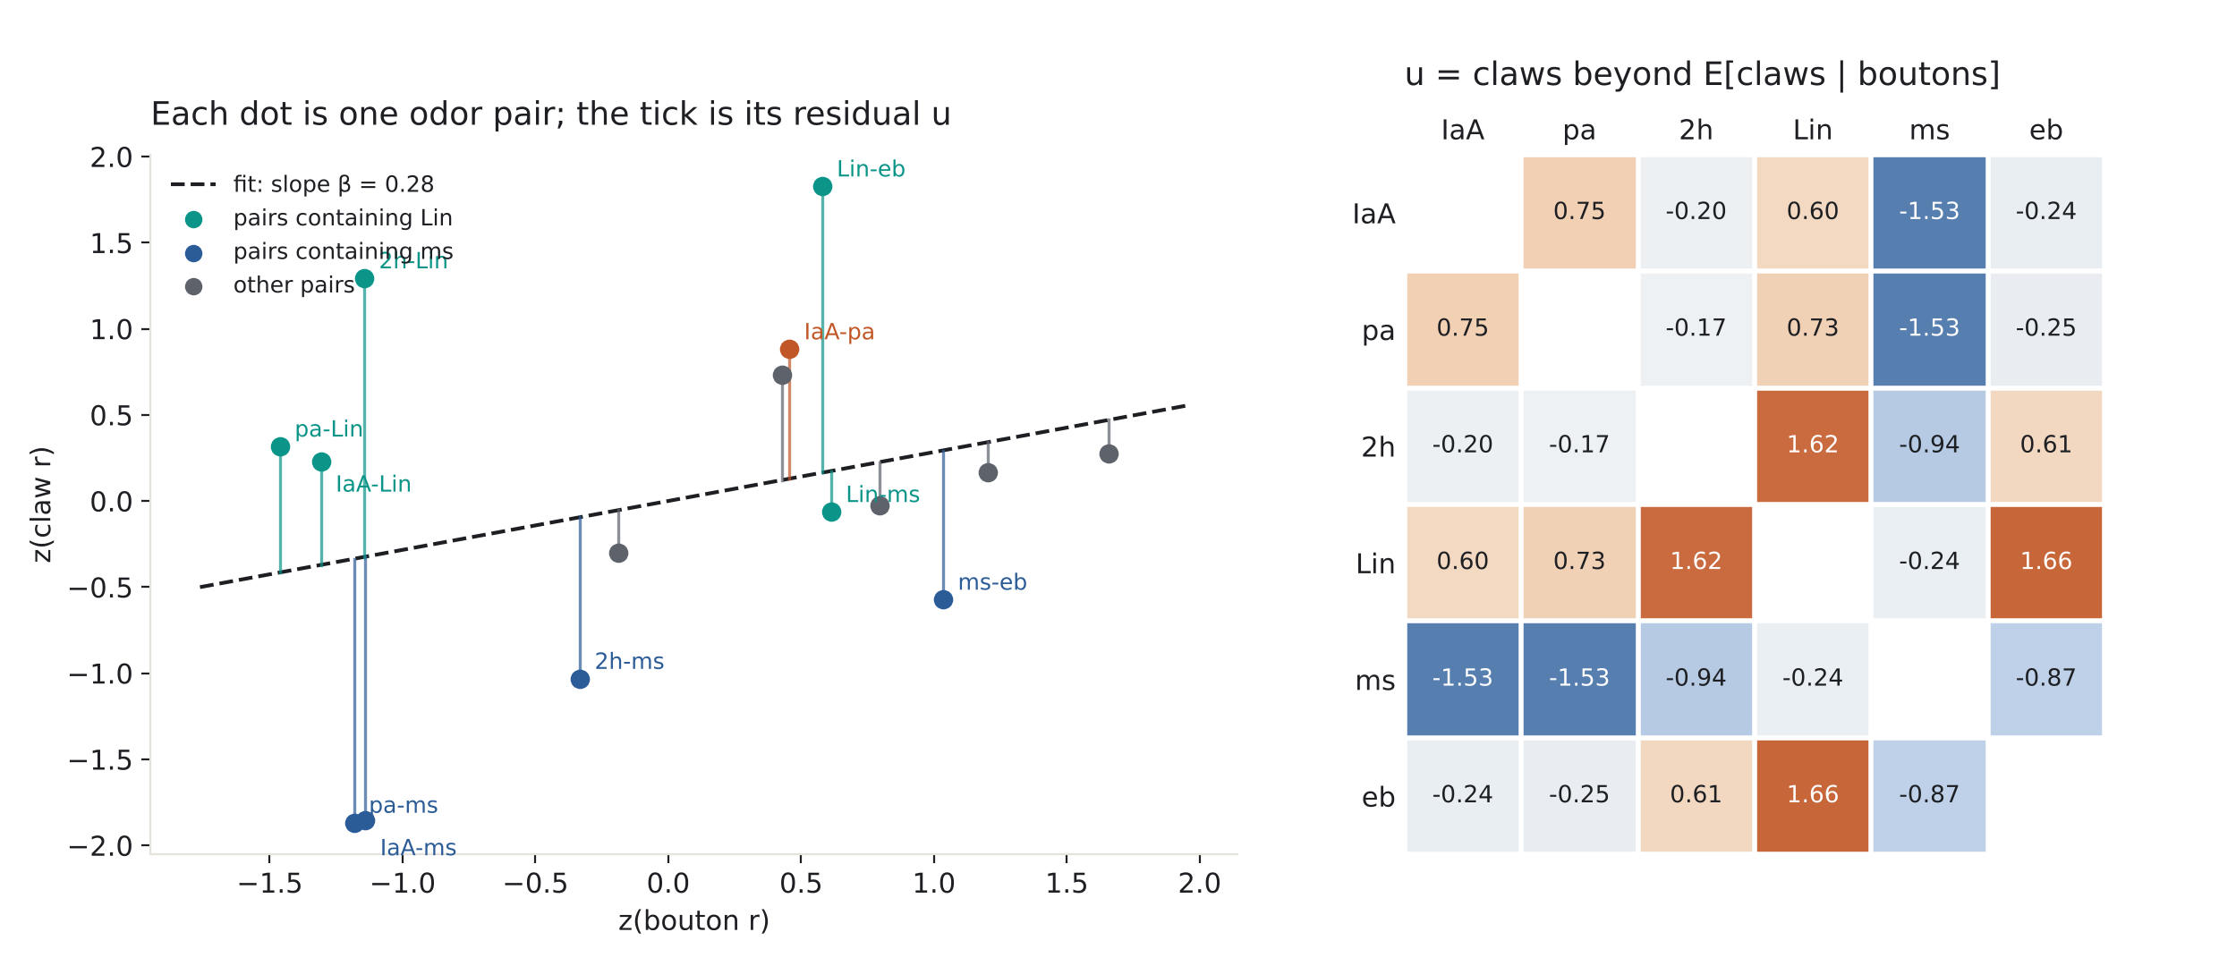
Regress out what boutons predict: the residual u is where the plants live
APPENDIX · CLAWS BEYOND E[CLAWS | BOUTONS]
Teal: pairs with Lin. Blue: pairs with ms. Rust: IaA–pa. The tick from the line to the dot is u for that pair.
z-score the 15 off-diagonal entries of each matrix, regress z(claws) on z(boutons) (slope β = 0.28), keep the residual u. Every Lin pair sits above the line, every ms pair below it, and IaA–pa is above the line on its own.
Odor part, pair part · 18 · Appendix
Appendix · A toy pathway with planted shifts
Notes:
This is exactly the Figure 7 construction on the toy. The slope is low (0.28) because the planted changes are large relative to the toy’s baseline; in the data it is higher. What matters is the pattern of residuals: a whole row of pairs displaced in the same direction is an odor-part signature (Lin up, ms down); one pair displaced on its own is a pair-part signature (IaA–pa). The u matrix on the right shows the same thing as a 6 × 6: the Lin column is positive, the ms column negative, and IaA–pa is the one positive entry in the IaA and pa rows.

Slide 19
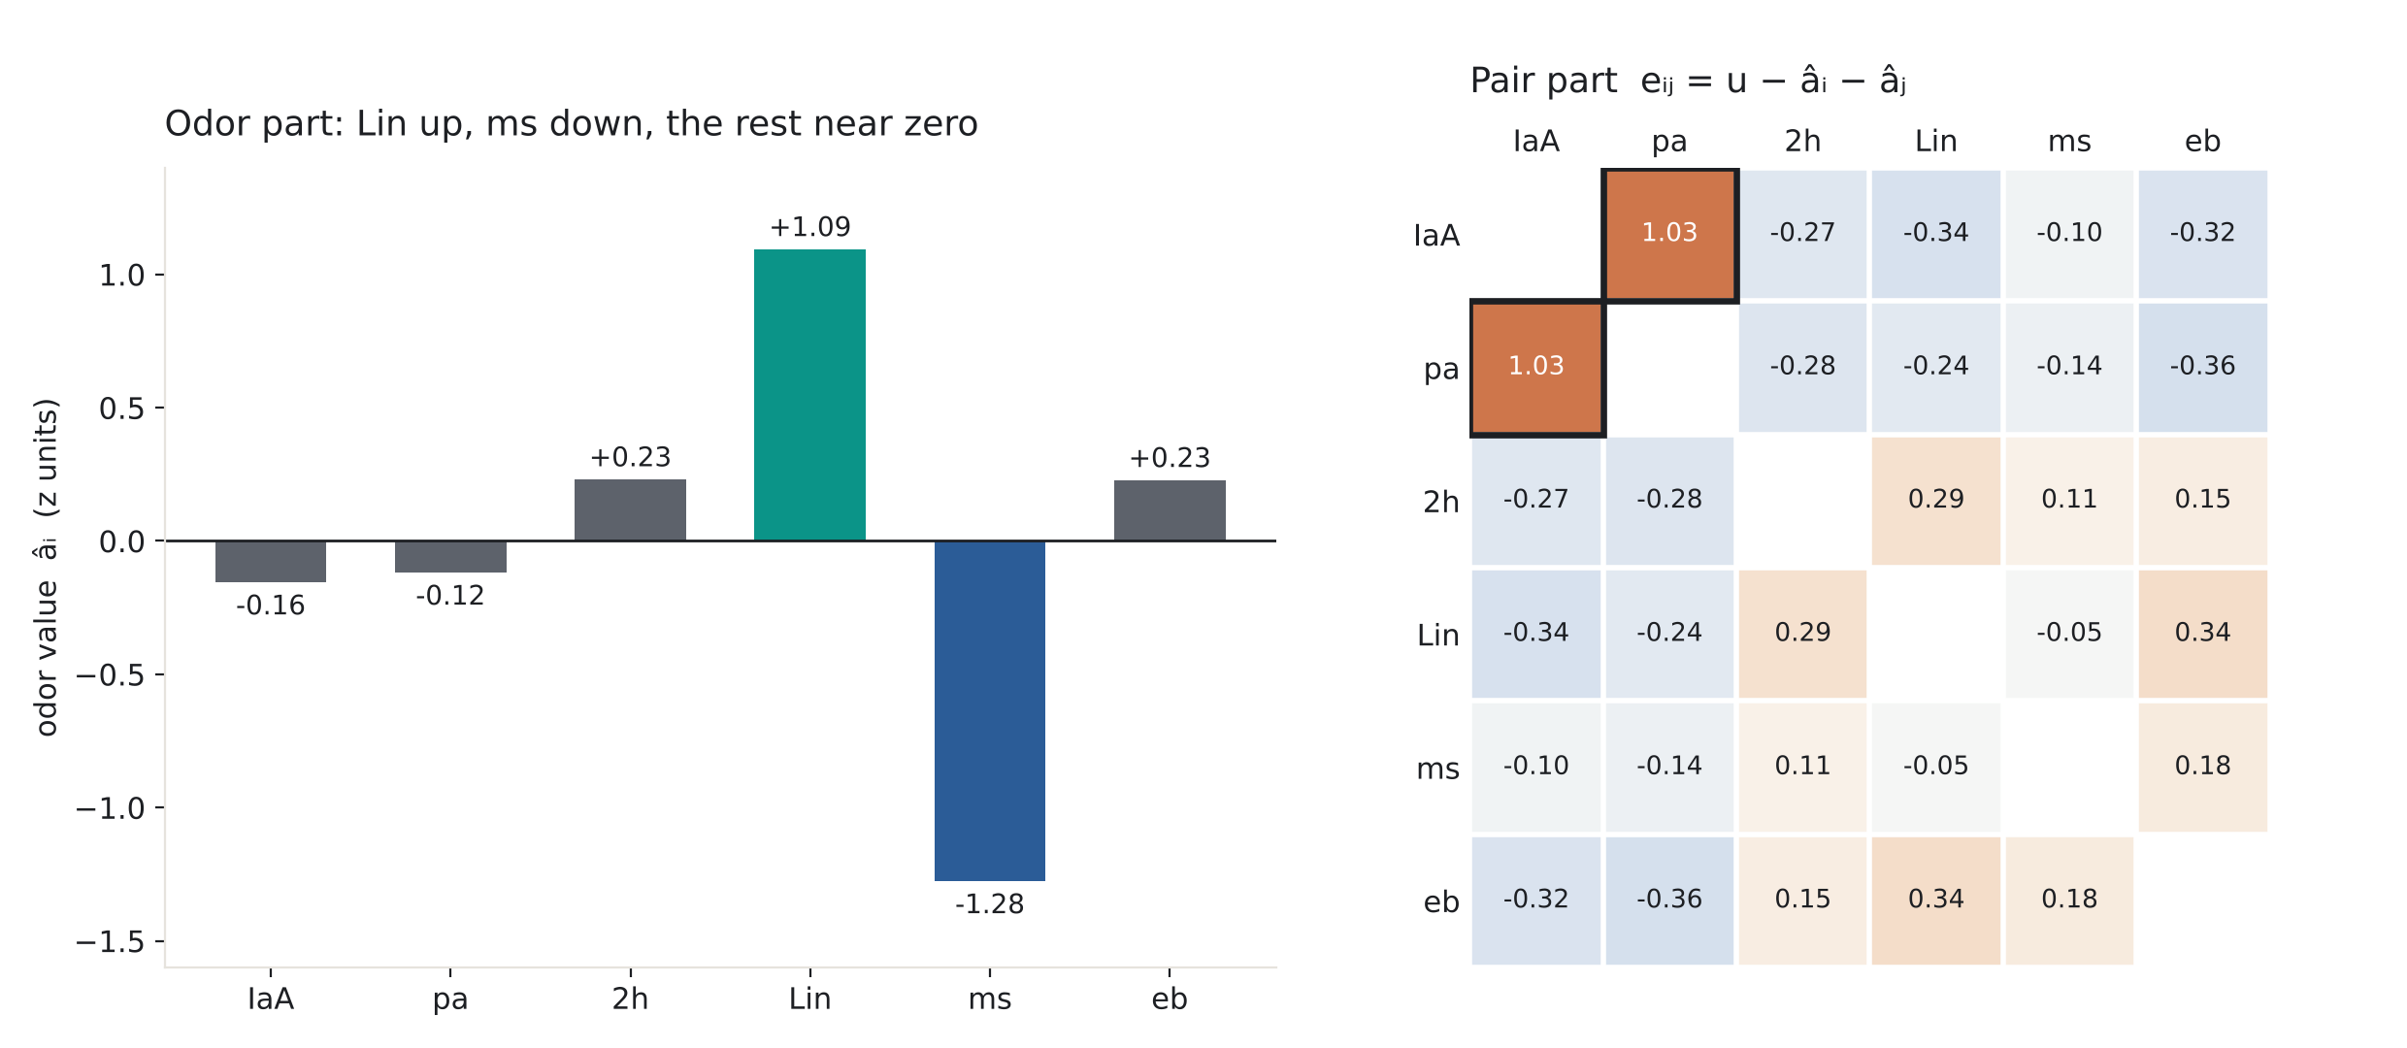
Fit u ≈ aᵢ + aⱼ on the 15 pairs: the odor part and the pair part each recover their planted shift
APPENDIX · THE DECOMPOSITION
Planted | Part | Found
Lin → cloud | odor | â = +1.09
ms ← cloud | odor | â = −1.28
IaA–pa axis | pair | e = +1.03
Others | odor | |â| ≤ 0.23
Others | pair | |e| ≤ 0.36
Each planted shift lands in its own part, at three to four times the size of anything not planted.
The small negatives in the IaA and pa rows of the pair part are the known leak: with n = 6, 2/(n − 2) = 0.50 of the odor values spreads additively along each row, and zero row sums force the +1.03 to be balanced within its rows. With 17 odors the leak is 0.13.
Odor part, pair part · 19 · Appendix
Appendix · A toy pathway with planted shifts
Notes:
The fit is the analysis code’s off-diagonal least squares, odor values centred. Lin +1.09 and ms −1.28 against |â| ≤ 0.23 for the four untouched odors; e(IaA, pa) = +1.03 against |e| ≤ 0.36 elsewhere. By Proposition 3 these are, up to the 6/4 factor and z-scaling, the differences in ⟨dᵢ, m⟩ and ⟨dᵢ, dⱼ⟩ between claws and β-scaled boutons. Two honest limits of the toy: there is no noise, so no reliability leak to show, and n = 6 makes the additive leak large (0.50 of the odor values, against 0.13 for 17 odors); both are why the real analysis disattenuates and uses 17 odors.

